Slide 1
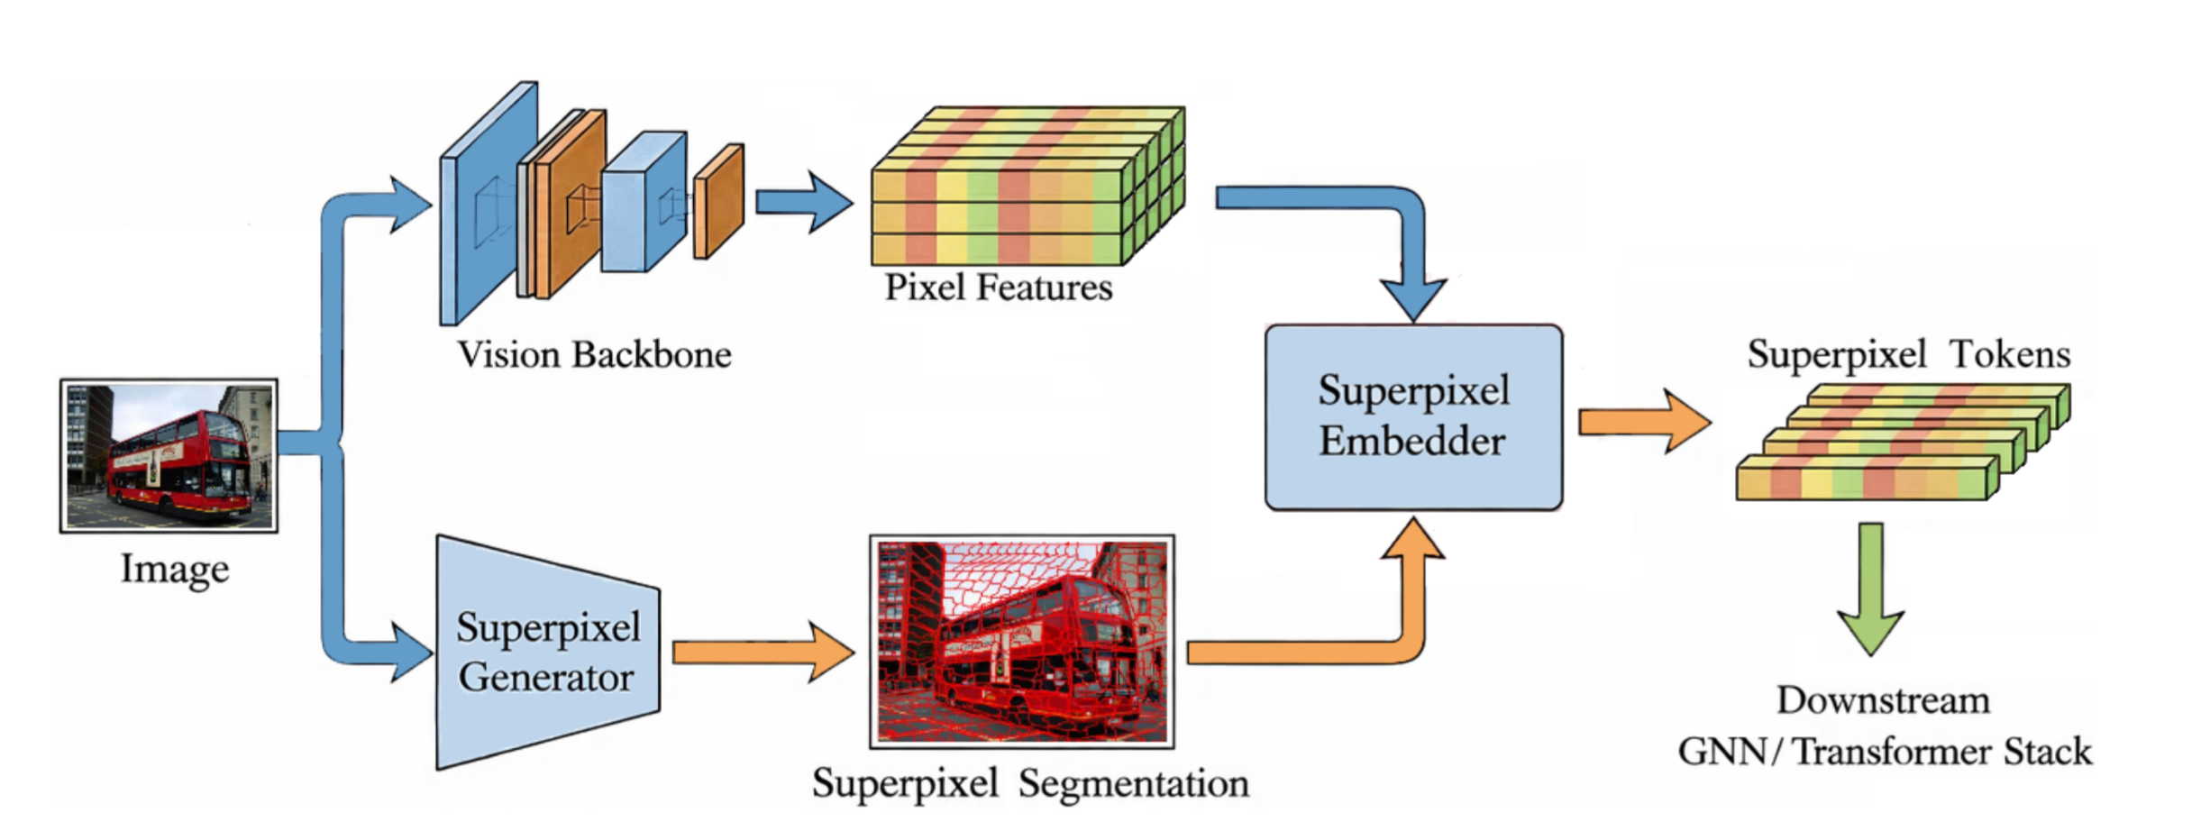
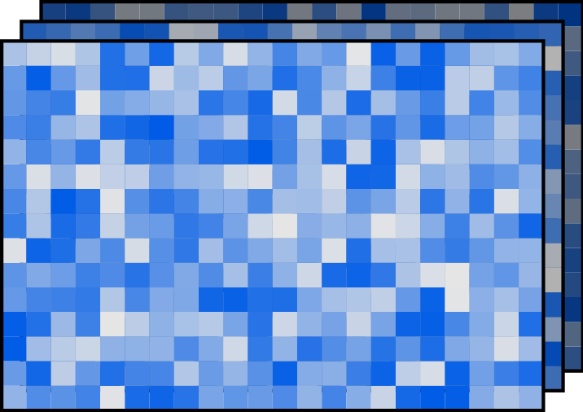
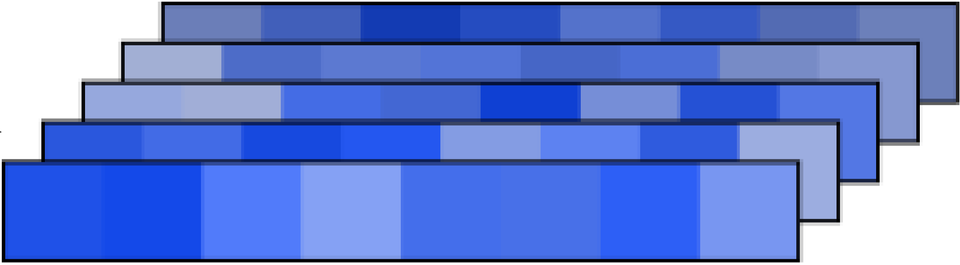
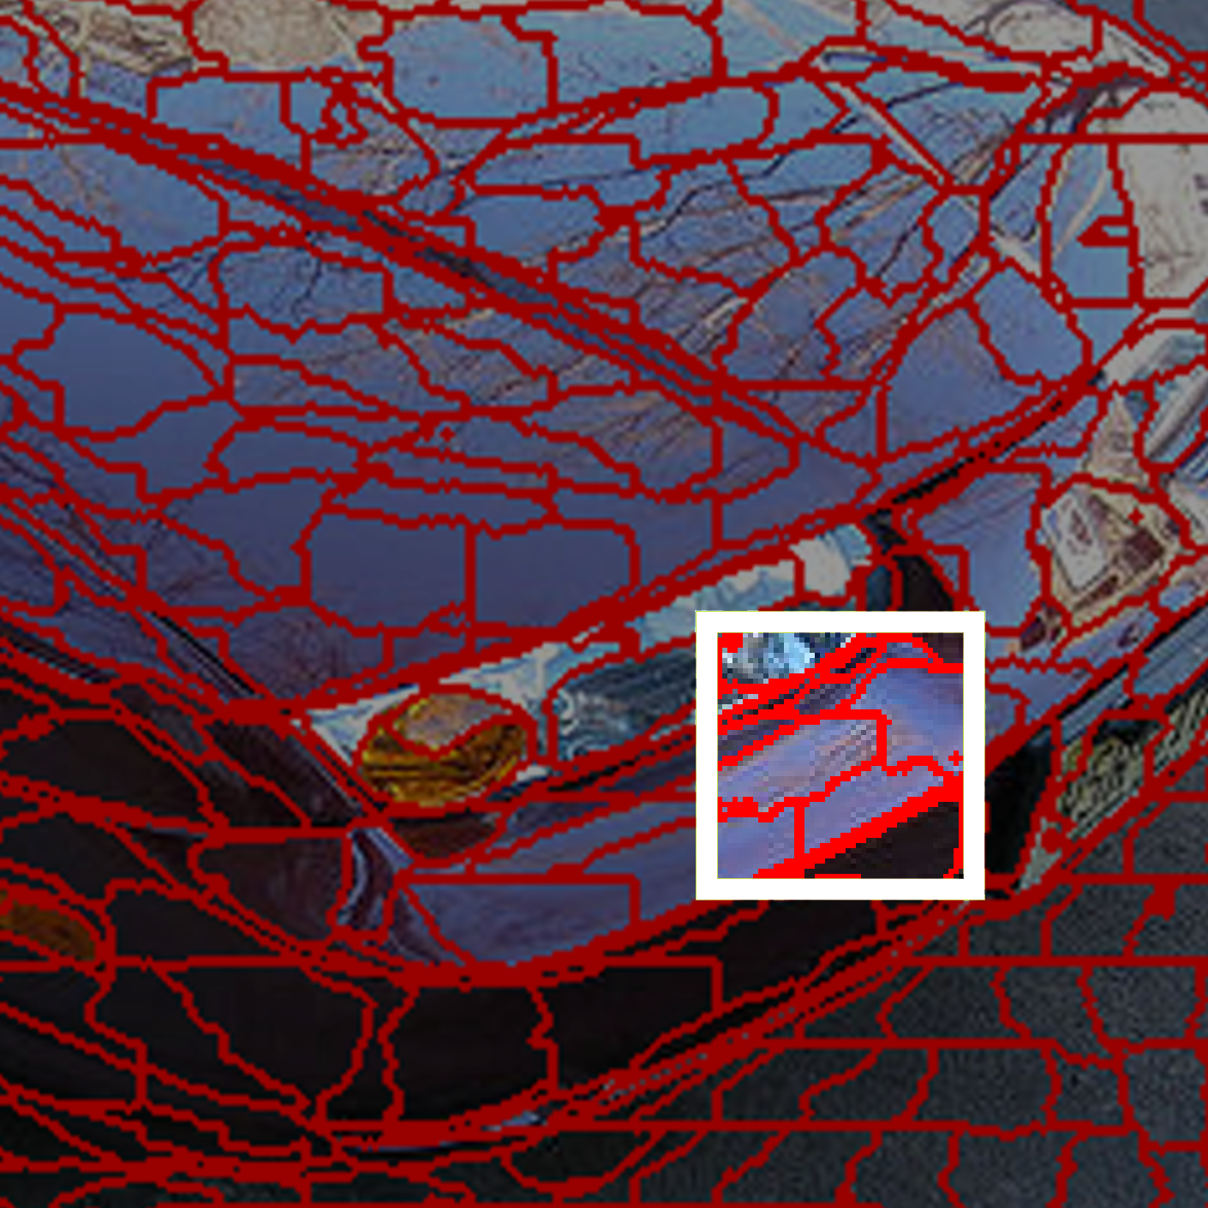
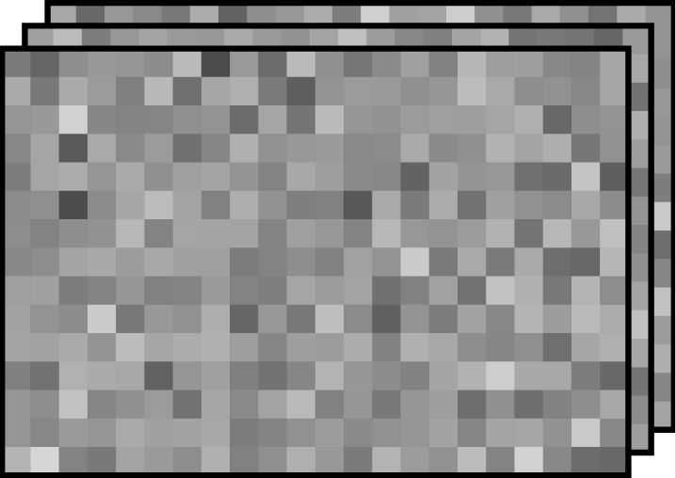
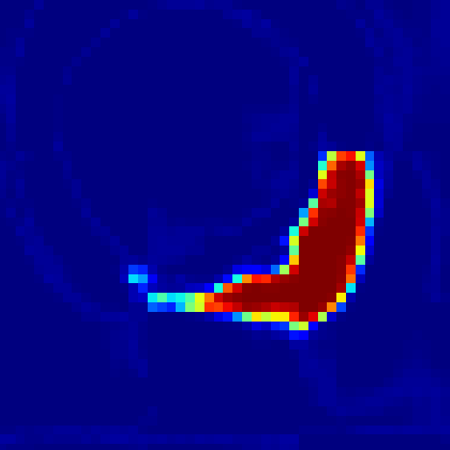
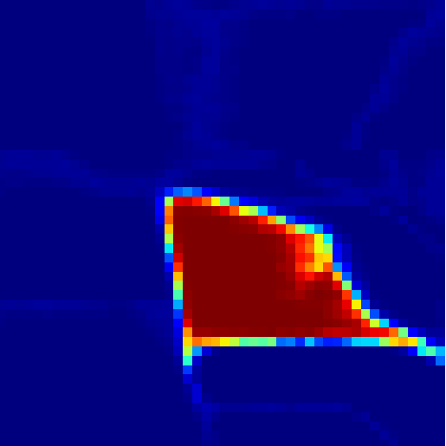
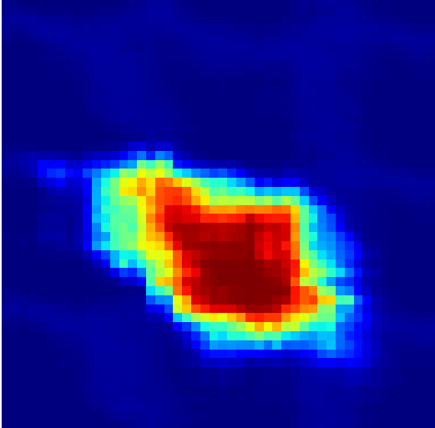
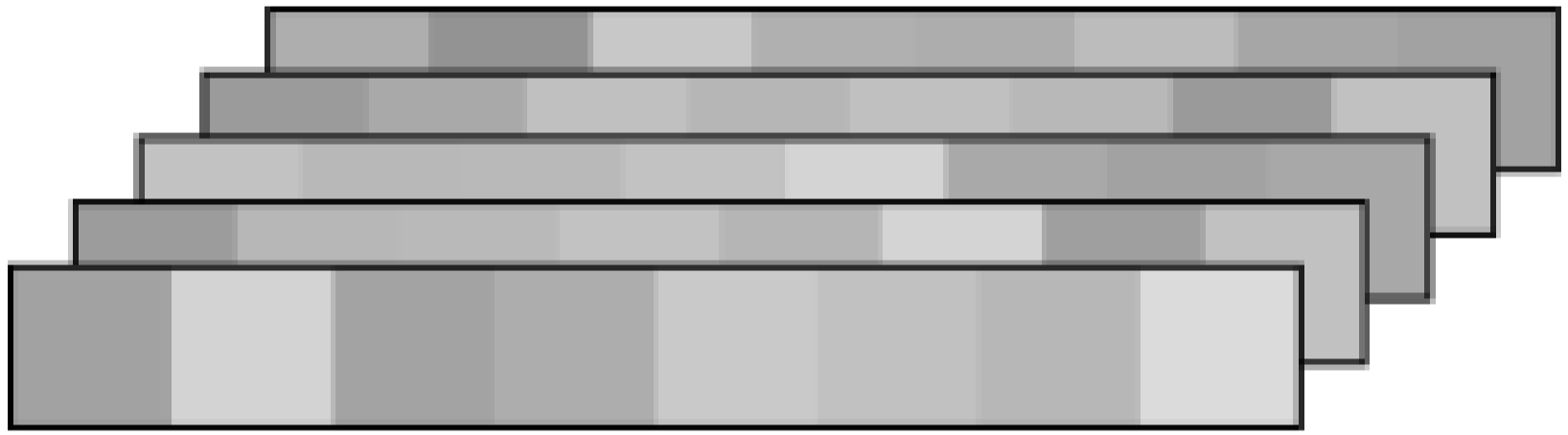
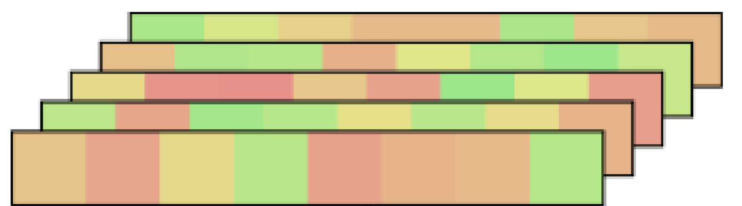
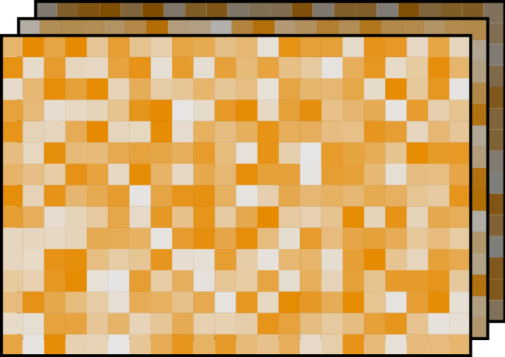

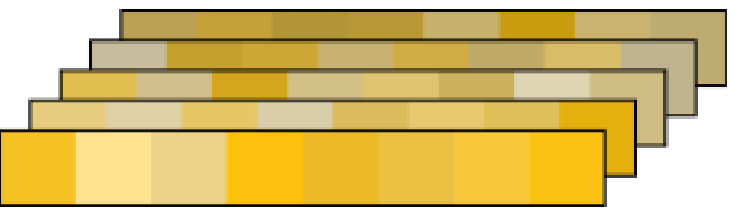










Superpixels'
Physical Carrier
Embeddings of Three Branchs
Five Factors
of a Superpixel
Color
Pixel Features $F$
Appearance Emb. $z^{app}$
Weighted Pooling by $Q$
FiLM-Style
Gated
Fusion
Module
Texture
Affinity Matrix $Q$
Geometry Emb. $z^{geo}$
Shape
Seed-Centered Affinity Reassembly Operation
Geometry Encoder
Scale
Seed-Centered Local Affinity Map $Q^{′}$
Superpixel Embedding $z$
Superpixel
Absolute Position $P$
Position Emb. $z^{pos}$
Position
Weighted Pooling by $Q$
Position
Embedding
Centroid

